Slide 1

Enhancing Conversational AI Model Performance and Explainability for Sinhala-English Bilingual Speakers
2022-056

Slide 2
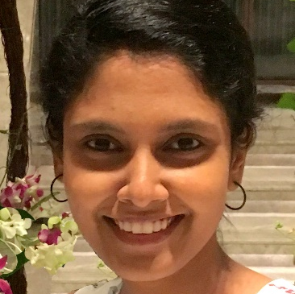
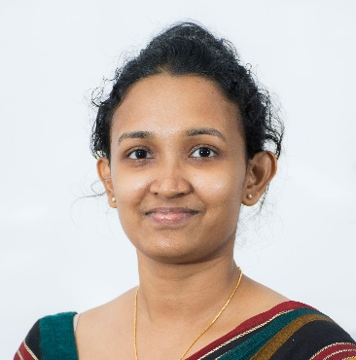




The Team
Supervisor
Dr. Lakmini Abeywardhana
Co – Supervisor
Ms. Dinuka Wijendra
Dissanayake D.M.I.M.
IT19069432
Hameed M.S.
IT19064932
Jayasinghe D.T.
IT19075754
Sakalasooriya S.A.H.A.
IT19051208

Slide 3
Overall Project Description
1
2
3
Research Background
Research Problem
Research gap
4
5
6
Research Objectives
Overall system architecture
Gantt chart

Slide 4

Background

Slide 5

Chatbots versus Conversational AIs
Chatbots vs Conversational AIs
Why NLP?
Entities and
Intents
Sparse and Dense Feature Engineering
Maintenance & Testing

Slide 6

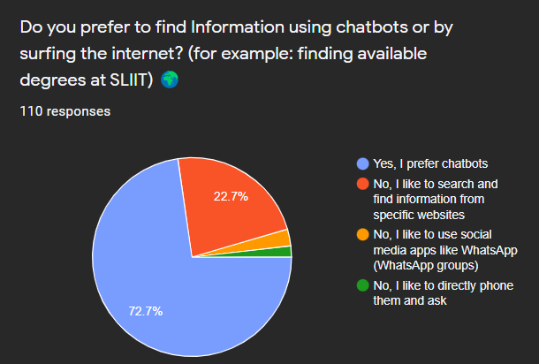
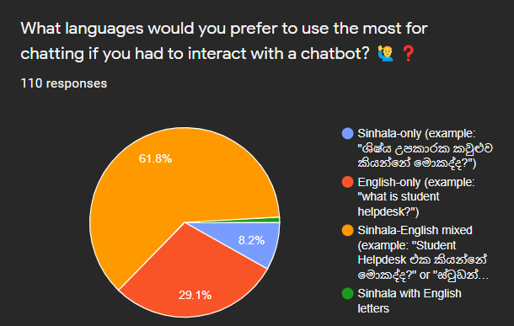
Survey Findings

Slide 7

Research Problem

Slide 8

What’s Lacking?
Support for Sinhala-English code-switched text processing in chatbots
Explanations for how chatbot models make predictions
Bilingual Speakers and Keyboard Interfaces
Maintenance and Evaluations for Non-ML Experts

Slide 9


Research Gap

Slide 10

A Brief Comparison
Tool / Research | Integrated Explainable AI Support | Integrated Code-less Data Improvement | Model Evaluation Expertise | Equivalent Token Mapping | Entity Annotation
Rasa Open Source | No | No | ML Expert | No | Manual, one by one
DialogFlow | No | Yes, Cloud based | Only Analytics. No Model Evaluation | No | Automated Expansion, Fuzzy Matching
Sally (This Research) | Yes | Yes | None ML Expert | Yes | Variation Matching

Slide 11


Objectives

Slide 12

What to Expect?
NLP Tools attachable to modern chatbot frameworks for Sinhala-English Code-Switched text
Efficient Entity Annotation
Bilingual Keyboard Interface
ML model Explanations for chatbots
Code-less Chatbot Maintenance
ML Model Evaluations for Non-Experts

Slide 13

Overall Architecture

Slide 14










GCP INSTANCE
DOCKER
RASA NLU SERVER (EXPANDED)
MODEL EVALUATION AND MAINTENANCE
COMPONENT + API
DATA ANNOTATION TOOL FOR CUSTOM ENTITY TAGGING + FLASK API
RASA NLU PIPELINE
CONVERSATIONAL AI ASSISTANT END-USER
OTHER PIPELINE COMPONENTS
XAI COMPONENT
+ FLASK API
TOKEN MAPPING TOOL + FLASK API
CUSTOM ENTITY RECOGNITION MODEL
SHARED DOCKER VOLUME WITH RASA DIRECTORIES
TRACKER STORE DATABASE TO STORE CONVERSATIONS
TOKEN MAPPING ALGORITHM + WORD EMBEDDINGS MODEL
TEST RESULTS +
TRAINING DATA +
RASA CONFIGS +
RASA DIRECTORIES
OTHER PIPELINE COMPONENTS
CONVERSATIONAL AI ASSISTANT MAINTAINER
RASA ACTION SERVER
RASA NLU+CORE SERVER
NGINX
WEB SERVER
CONVERSATIONAL AI MANAGEMENT ARTIFACTS
CONVERSATIONAL AI ARTIFACTS
CADDY/NGINX REVERSE PROXY
CONVERSATIONAL AI ASSISTANT MODEL TESTER

Slide 15











Technologies
Backend Development
Frontend Development
Python
TensorBoard
React
Socket.IO
Rasa
pandas
spaCy
Flask
NoSQL Database Development
Gensim
MongoDB

Slide 16





Technologies
Deployment
Source-code management
Docker
Nginx
Git
GCP
Caddy

Slide 17

Gantt Chart

Slide 18
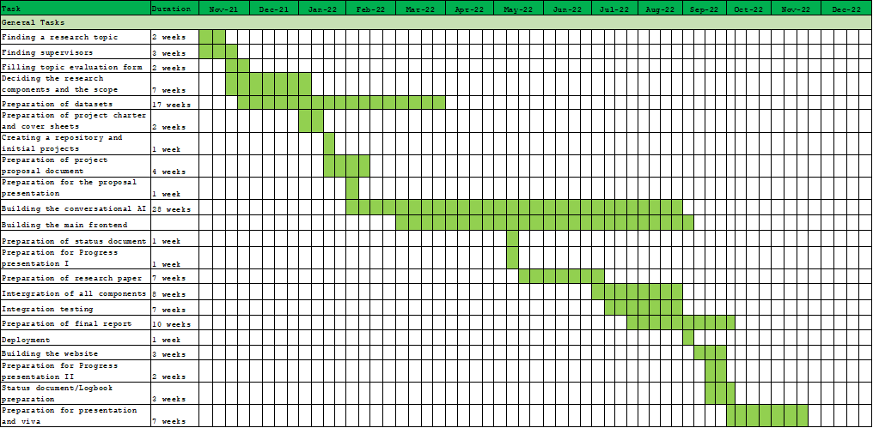

Slide 19

DIME: Dual Interpretable
Model-Agnostic Explanations
Using global explanations to generate local interpretations
in intent classification models using explainable AI
Dissanayake D.M.I.M.
IT19069432
Data Science

Slide 20

Research Component Background
What is XAI?
Accuracy-Interpretability Trade-off
Global vs Local Explanations

Slide 21

Research Component Gap
Research/ Tool
Intrinsic/ Post hoc
Local/ Global Explanations
Model Specificity
Feature Engineering
Feature Contribution Score
LIME [1]
Post hoc
Local
Model Agnostic
Ridge Regression
Local Linear Surrogate Model
SHAP [2]
Post hoc
Global or Local
Model Agnostic
All features with Approximation
Shapley Values
DIME
(This Research)
Post hoc
Local using Global
Model Agnostic
Global Feature Importance
Shapley Values

Slide 22

Research Component Question
Cannot Trust &
Debug ML Models
Why not blending Local & Global Explanations?
Explainability in modern Chatbot Frameworks

Slide 23
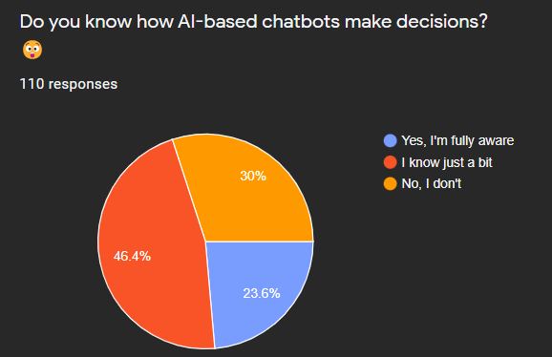
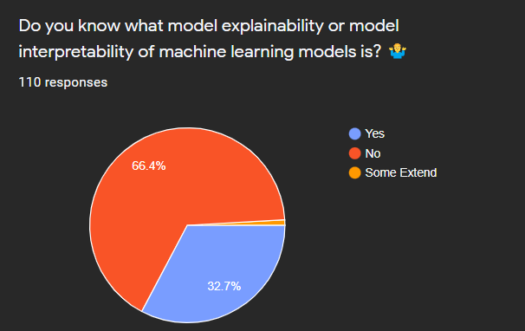
Survey Findings

Slide 24

Specific Objective
Develop DIME, an Explainable AI approach to deliver local model explanations with the help of global feature importance.

Slide 25

Sub Objectives
Find Global and Local Explanations logically
Develop a python package for DIME
Modify DIET intent classifier to get all confidence scores
Visualize explanations in an interpretable manner
Integrate DIME with Rasa seamlessly

Slide 26

Functional Requirements
DIME should provide methods to calculate global and local explanations
DIME should provide a local server as a visualization tool
DIME should be applicable to any ML model that outputs confidence scores for predictions
DIME should ask the users number of features to generate explanations
DIME should utilize caching to optimize calculations

Slide 27

Non-functional Requirements
Efficient Calculations
Reliable Explanations
Simple & Interpretable Visualizations
Modular package

Slide 28

Proposed Methodology
1
2
3
Build a Dataset for Rasa conversational AI Training
Train a Rasa Conversational AI
Develop the DIME Algorithm Using the Trained Model
4
5
6
Develop DIME Server to Support any Rasa Chatbot by default
Compare Different Techniques for Global Feature Importance
Evaluate DIME & Integrate with the Overall System

Slide 29

Global feature Importance
Finding Global Feature Importance for “මොනවද ”:
Original Dataset
Observe the Accuracy
1. ඔයාලගෙ මොනවද තියෙන ඩිග්‍රි?
2. SLIIT එකේ තියෙන උපාධි මොනවද?
3. Foundation courses කියන්නෙ මොනවද
4. Repeat එකකට කීයක් වෙනවද
...
Correct
Correct
Incorrect
Correct
...
Accuracy for original dataset = 3/4

Slide 30
Global feature Importance
Finding Global Feature Importance for “මොනවද ”:
Altered Dataset
Observe the Accuracy
1. ඔයාලගෙ මොනවද තියෙන ඩිග්‍රි?
2. SLIIT එකේ තියෙන උපාධි මොනවද?
3. Foundation courses කියන්නෙ මොනවද
4. Repeat එකකට කීයක් වෙනවද
...
Correct
Incorrect
Incorrect
Correct
...
Accuracy for original dataset = 1/2
Global Feature Importance for “මොනවද ” = change in the accuracy = 0.25

Slide 31

Local Model Explanations
Number of Features: 2
Explanations Plot:
Global Feature
Importance Scores:
ඩිග්‍රි 0.2062
SLIIT 0.1401
එකේ 0.0001
උපාධි 0.0012
මොනවද 0.0001
Foundation 0.0089
කියන්නෙ 0.0001
Repeat 0.0099
එකකට 0.0003
කීයක් 0.002
... ...
Not Degrees Degrees
DIME
උපාධි
මොනවද?
Local Example:
ඔයාලගෙ තියෙන උපාධි වර්ග මොනවද?
Predicted Class: Degrees

Slide 32

Work Breakdown
Structure

Slide 33
DIME
1
Data Preparation
Conversational AI Building
Algorithm Development
4
Implementation
Deployment
2
3
5
Data Collection
Add Training Data
Global Feature Importance
Integrate DIME with Rasa
Update the GIT Repository
Data Augmentation
Build NLU pipeline
Local Model Explanations
Build Docker Images
Set up GCP Instance
Data Deduplication
Modify DIET Classifier
Build the DIME Core Package
Write Docker Compose Configs
Deploy Docker Containers
Data Preprocessing
Train a model
Develop local Visualizations Server
Build Caddy and NGINX Servers
Test DIME after Deployment
Integrate component UI with the Main UI
Compare and Evaluate DIME explanations with LIME

Slide 34

Individual Component Architecture

Slide 35
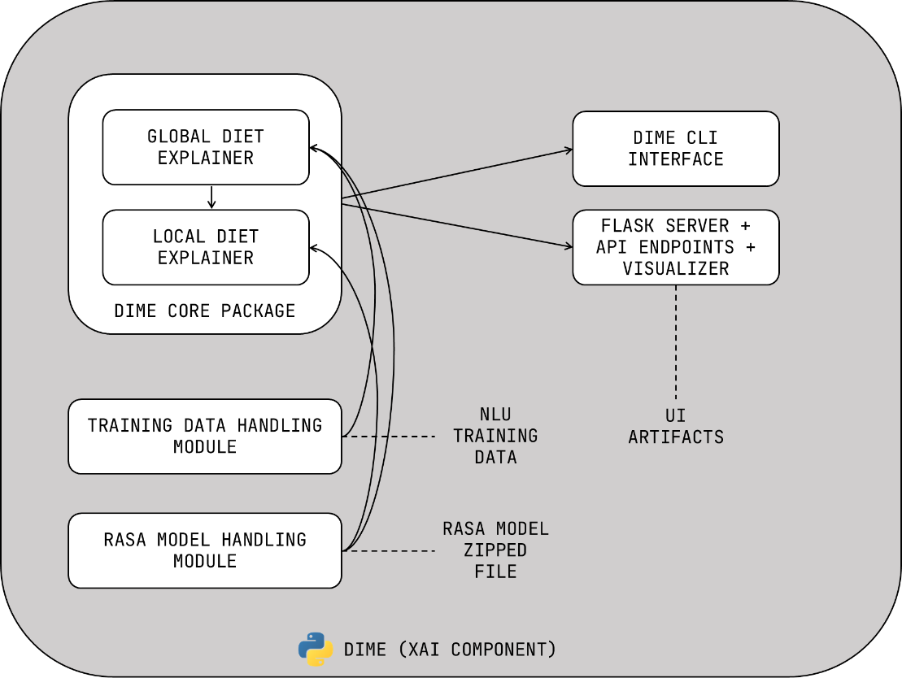

Slide 36

Individual
Gantt Chart

Slide 38
References
[1]. M. T. Ribeiro, S. Singh, C. Guestrin, “‘why should I trust you?’: Explaining the predictions of any classifier,” 16 Feb 2016. [Online]. Available: https://arxiv.org/abs/1602.04938
[2]. S. Lundberg, S. Lee, “A Unified Approach to Interpreting Model Predictions,” 2017. [Online]. Available: https://arxiv.org/abs/1705.078744
[3]. T. Bunk, D. Varshneya, V. Vlasov, A. Nichol, “DIET: Lightweight Language Understanding for Dialogue Systems,” 2020. [Online]. Available: https://arxiv.org/abs/2004.09936

Slide 39

Code-less Maintenance and
Model Performance Evaluation
Enabling non-machine learning experts to effectively improve and evaluate conversational AI machine learning models
Hameed M.S.
IT19064932
Software Engineering

Slide 40

Research
Background
Training Machine Learning Models
Model Performance Evaluation and Tools used
Model data Improvement and Tools used

Slide 41

Research Gap for
Data Improvement
Name/Reference | Tool/Research | Requires knowledge about the backend | Conversation Driven Development | Requires knowing CLI commands
Rasa [1] | Tool | Yes | No | Yes
Rasa X [2] | Tool | Yes | Yes | No
This Research Component | Tool | No | Yes | No

Slide 42

Research Gap for
Model Evaluation
Name/Reference | Tool/Research | Overfitting/Underfitting indicators | Suggest the best epoch range to train the model | Requires knowledge about the backend to understand the feedback
Rasa [1] | Tool | No | Yes (Early stopping) but no visual indication | Yes
This Research Component (LCE) | Tool | Yes | Yes | No

Slide 43

Research
Question
Can machine learning models be improved using Conversation Driven Development without having the knowledge to handle the backend?
Can machine learning model performance be evaluated without knowing how to interpret learning curves?

Slide 44
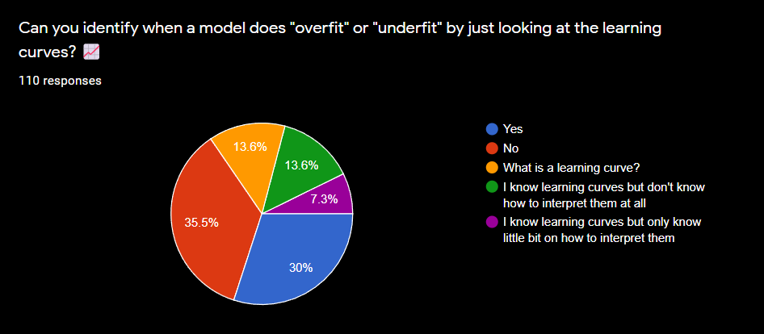
Survey Findings

Slide 45

Specific
Objective
Develop an efficient and code-less approach to improve and evaluate conversational AI machine learning models for non-machine learning experts

Slide 46

Sub
Objectives
Developing an interface to allow making improvements to model training data without any coding knowledge.
Developing a solution for non-technical users to efficiently retrain and deploy new machine learning models.
Developing an algorithm to identify any overfittings or underfittings in a model and indicate it in the frontend.

Slide 47

Research Component Requirements
Functional Requirements | Non-Functional Requirements
LCE should denote any overfittings or underfittings in the trained model | Model evaluations should be reliable
LCE should suggest the appropriate range of epochs to use to train the model | Model evaluations should be consistent
Should be able to use conversations users have had with the conversational AI, to improve the machine learning model (CDD) | LCE should not hinder the model training time
*LCE = Learning Curve Explainer

Slide 48

Proposed Methodology
1
2
3
Build a Dataset for Rasa conversational AI Training
Train a Rasa Conversational AI
Develop the LCE Algorithm Using the Trained Model
4
5
6
Develop LCE Server to Support any Rasa Chatbot by default
Compare Different Approaches for Smoothing Techniques
Integrate with the Overall System

Slide 49
Model
Evaluation
1
2
3
Build a Dataset for Rasa conversational AI Training
Train a Rasa Conversational AI with TensorBoard enabled
Feed the data point values to the LCE algorithm
4
5
6
Use regularization techniques to smooth out the curve if the model has too many spikes
Identify overfittings or underfittings using the spikes in the curve
Provide evaluation to the user along with recommended epoch to use

Slide 50

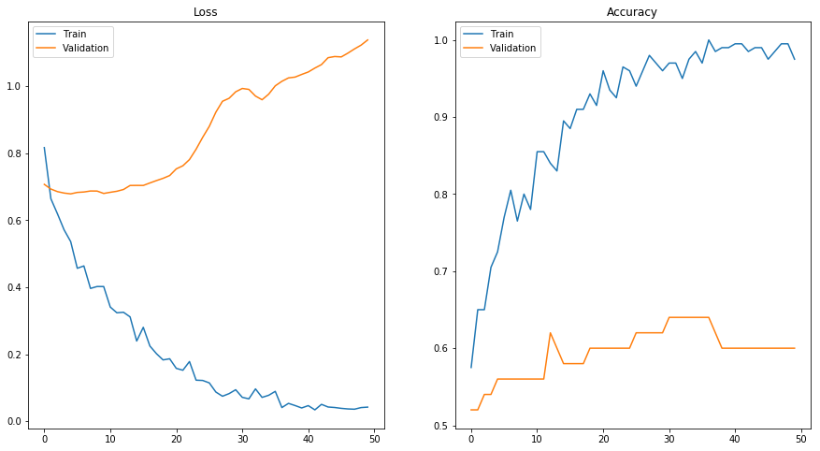
Sample Image of a
Model Overfitting
Source: https://towardsdatascience.com/dont-overfit-how-to-prevent-overfitting-in-your-deep-learning-models-63274e552323

Slide 51
Data Improvement

Slide 52

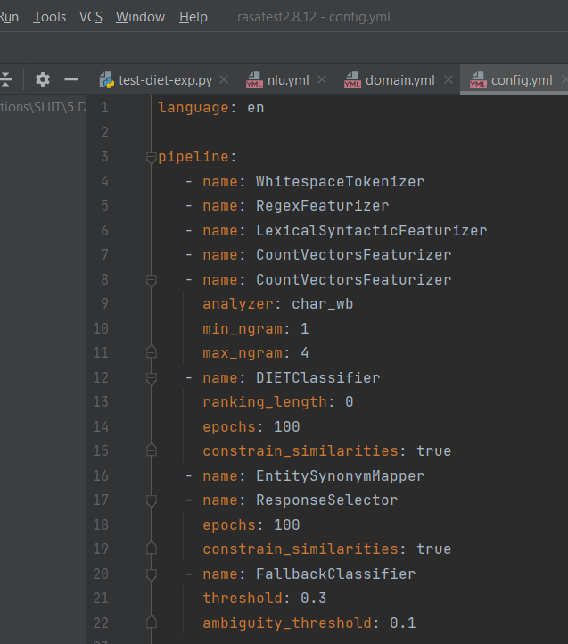


Modify Rasa NLU Configurations
Select an Intent Classifier:
DIET Classifier
Advanced Component Configurations:
Epochs
Ranking Length
Train

Slide 53

Work Breakdown Structure
1
Data Preparation
Building Conversational AI
Algorithm Development
4
Implementation
Deployment
2
3
5
Data Collection
Add Training Data
Read TensorBoard Results
Integrate LCE with Rasa
Update the GIT Repository
Data Augmentation
Build NLU pipeline
Develop Learning Curve Explainer algorithm to interpret TensorBoard Results
Build the Frontend
Set up GCP Instance
Data Deduplication
Decide number of validation data points
Implement code-less Maintenance
Deploy Docker Containers
Data Preprocessing
Build Docker & Docker-compose files
Test LCE and Code-less Maintenance after Deployment
Enable TensorBoard
Build the LCE Package
Train a model
Build a Locally executable Server
Build Caddy and NGINX Servers
Testing NLU Model
Integrate component UI with the Main UI

Slide 54

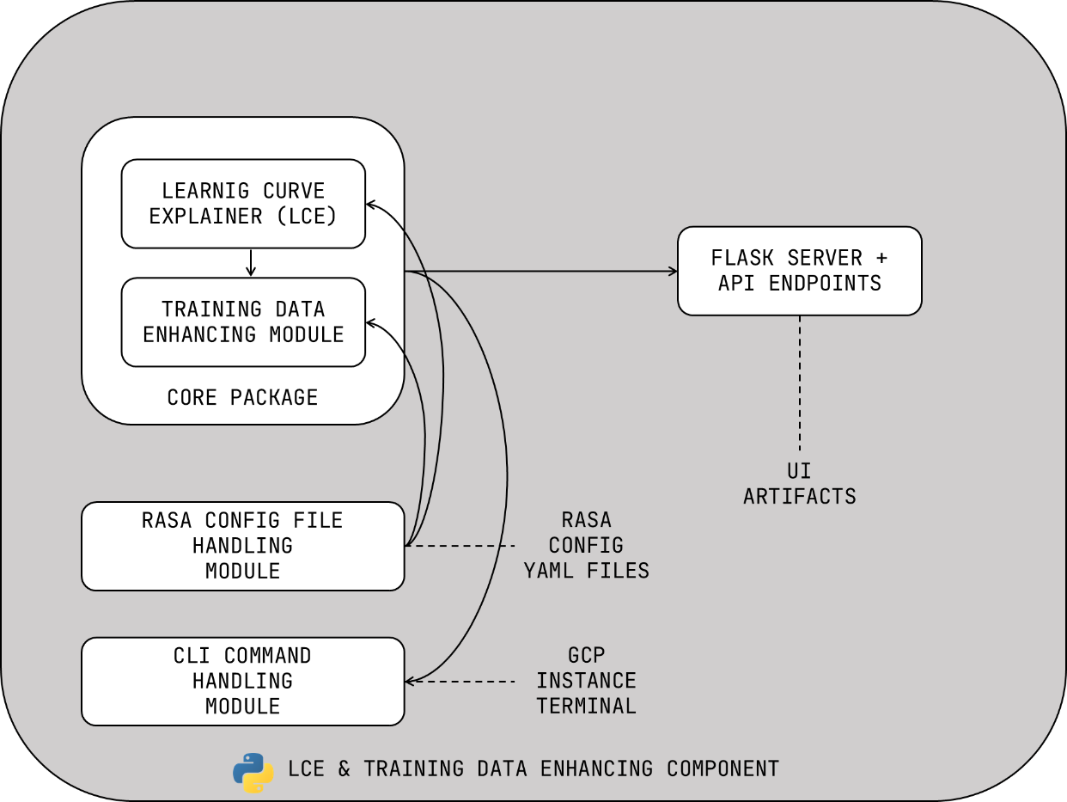
Individual Component
Architecture

Slide 55

Individual Gantt Chart

Slide 56
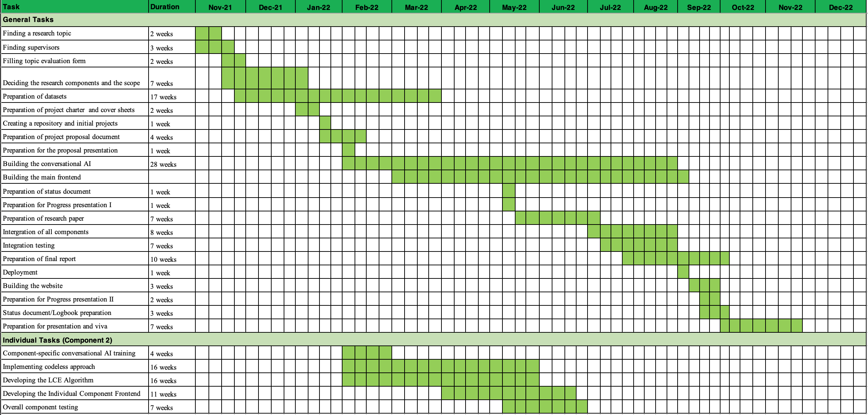

Slide 57

References
[1]. T. Bocklisch, J. Faulkner, N. Pawlowski, en A. Nichol, “Rasa: Open source language understanding and dialogue management”, arXiv preprint arXiv:1712. 05181, 2017.
[2]. “Introduction to rasa X,” Open source conversational AI, 10-Dec-2021. [Online]. Available: https://rasa.com/docs/rasa-x/. [Accessed: 22-Jan-2022].

Slide 58

SEETM: Sinhala-English
Equivalent Token Mapper
Developing rule-based approaches to process code-mixed textural data and make word embeddings models lightweight using token mapping.
Jayasinghe D.T.
IT19075754
Data Science

Slide 59
Research Background
Bilingual and Multilingual Speakers
Code-Mixing
Code-Switching
Equivalent Words

Slide 60

Code-Mixing VS
Code-Switching​​
Code-Mixing
How to apply for Library Membership?
Code-Switching
Library Membership ekata apply
karanne kohomada?
Library Membership එකට apply
කරන්නේ කොහොමද?

Slide 61
Research Background
Bilingual and Multilingual Speakers
Code-Mixing
Code-Switching
Equivalent Words

Slide 62

Equivalent words Examples
Mother
අම්මා
அம்மா
დედა
ਮੰਮੀ
Мама
English
Sinhala
Tamil
Georgian
Punjabi
Russian

Slide 63


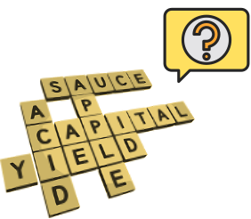

Research Questions
1
2
3
There are limited number of NLP researches on processing Sinhala-English code-switching text data
There are no Keyboard Interfaces in websites that can handle Sinhala English Code-switching text
Deep Learning NLP models need a lot of data.
It is hard to train Sinhala-English deep learning models due to low resources
Eg:
In Word embedding models trained for Sinhala-English code-switched text data, If training data has the word
“Mother” but not “අම්මා” the model considers අම්මා as an Out-of-vocabulary token. But they have the same meaning.

Slide 64


Specific
Objective
Assigning the same word vector to equivalent words in a Sinhala-English code-switched text corpus
SEETM

Slide 65

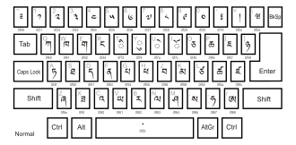
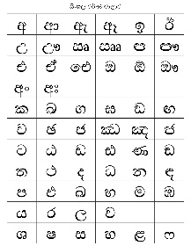

Sub
Objectives
OOV words Handling in
word embeddings
Bilingual Keyboard Interface
Lightweight
Word Embedding Models

Slide 66
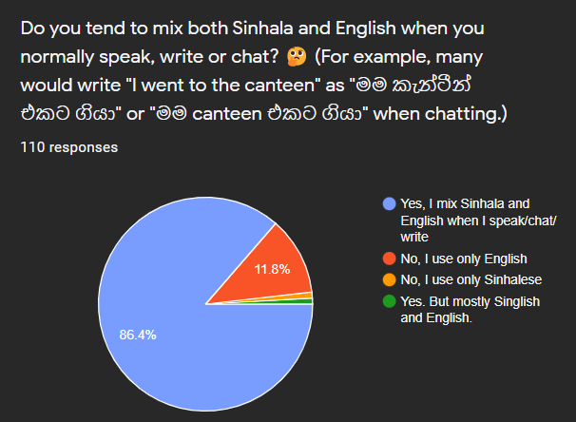
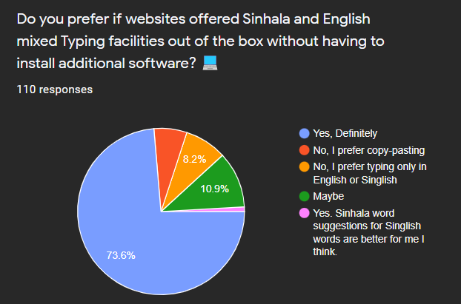
Survey Findings
Code-Switching
Sinhala – English Keyboard Interfaces

Slide 67

Research
Gap
Research Paper Reference | Languages Used | Code-switched/ Code-mixed | Word Embeddings Model Type | Chatbot Framework | Special Data Pre-processing Techniques Proposed
[1] Paper | Sinhala | - | Word2Vec | - | Basic Text Preprocessing
[2] Paper | Sinhala (Main), English, Singlish | Code-Mixed Data | - | - | Dictionary Mapping (For Characters)
This Research Component | Sinhala (Main), English | Code-Switched Data | Word2Vec | Rasa | Equivalent Token Mapping And Character Mapping

Slide 68

Functional Requirements
1
SEETM should generate a single representation for equivalent words.
2
Mapped equivalent words should get a single vector representation.
3
SEETM should handle out-of-vocabulary words in Word2Vec models when at least one of the representations of equivalent tokens are present in training data.
4
Users should be able to type in both Sinhala and English in the User Interface.

Slide 69






Non-Functional Requirements
Efficiency
Reliability
Modularity
Scalability
Usability

Slide 70

Proposed Methodology
1
2
3
Build a Dataset for Token Mapping
Develop the SEETM Algorithm Using the Dataset
Train and Evaluation the SEETM Using Word2Vec Models
4
5
6
Developing the Frontend of the Component
Develop the Character Mapping For Keyboard Interface
Test and Integrate with the Overall System

Slide 71
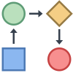
Component Architecture
Training Data
Word
Embeddings
model
Ask for Vector
Get vector for “Degree”?
OOV
ඔයාලගෙ මොනවද තියෙන ඩිග්‍රි?

Slide 72
Component Architecture
Training Data
Word
Embeddings
model
Ask for Vector
Get vector for “Degree”?
[40, 4, 99, 84]
ඔයාලගෙ මොනවද තියෙන ඩිග්‍රි?
SEETM
SEETM
ඩිග්‍රි maps
into ඩිග්‍රි
Degree maps
into ඩිග්‍රි
* Here, SEETM maps English Words to Sinhala Equivalent

Slide 73

Work Breakdown Structure
SEETM
1
Data Preparation
SEETM Algorithm Development
Sinhala-English Code-Switching Keyboard Interface
4
Implementation
Deployment
2
3
5
Data Collection
Develop Sinhala-English Character Map
Develop the Keyboard Interface Using Keystroke Mapping
Integrate SEETM with Rasa
Update the GIT Repository
Data Augmentation
Build Docker Images
Set up GCP Instance
Develop Equivalent Token Mapping Algorithm: SEETM
Data Deduplication
Utilizing the Character Map within the Keyboard Interface
Write Docker Compose Configs
Deploy Docker Containers
Data Preprocessing
Evaluate Token Mapping Manually
Build Caddy and NGINX Servers
Test SEETM and Keyboard Interface after Deployment
Training a Word2Vec Model
Enable Efficient Language Switching
Integrate component UI with the Main UI
Evaluating Token Mapping Effect on Word2Vec Model

Slide 74

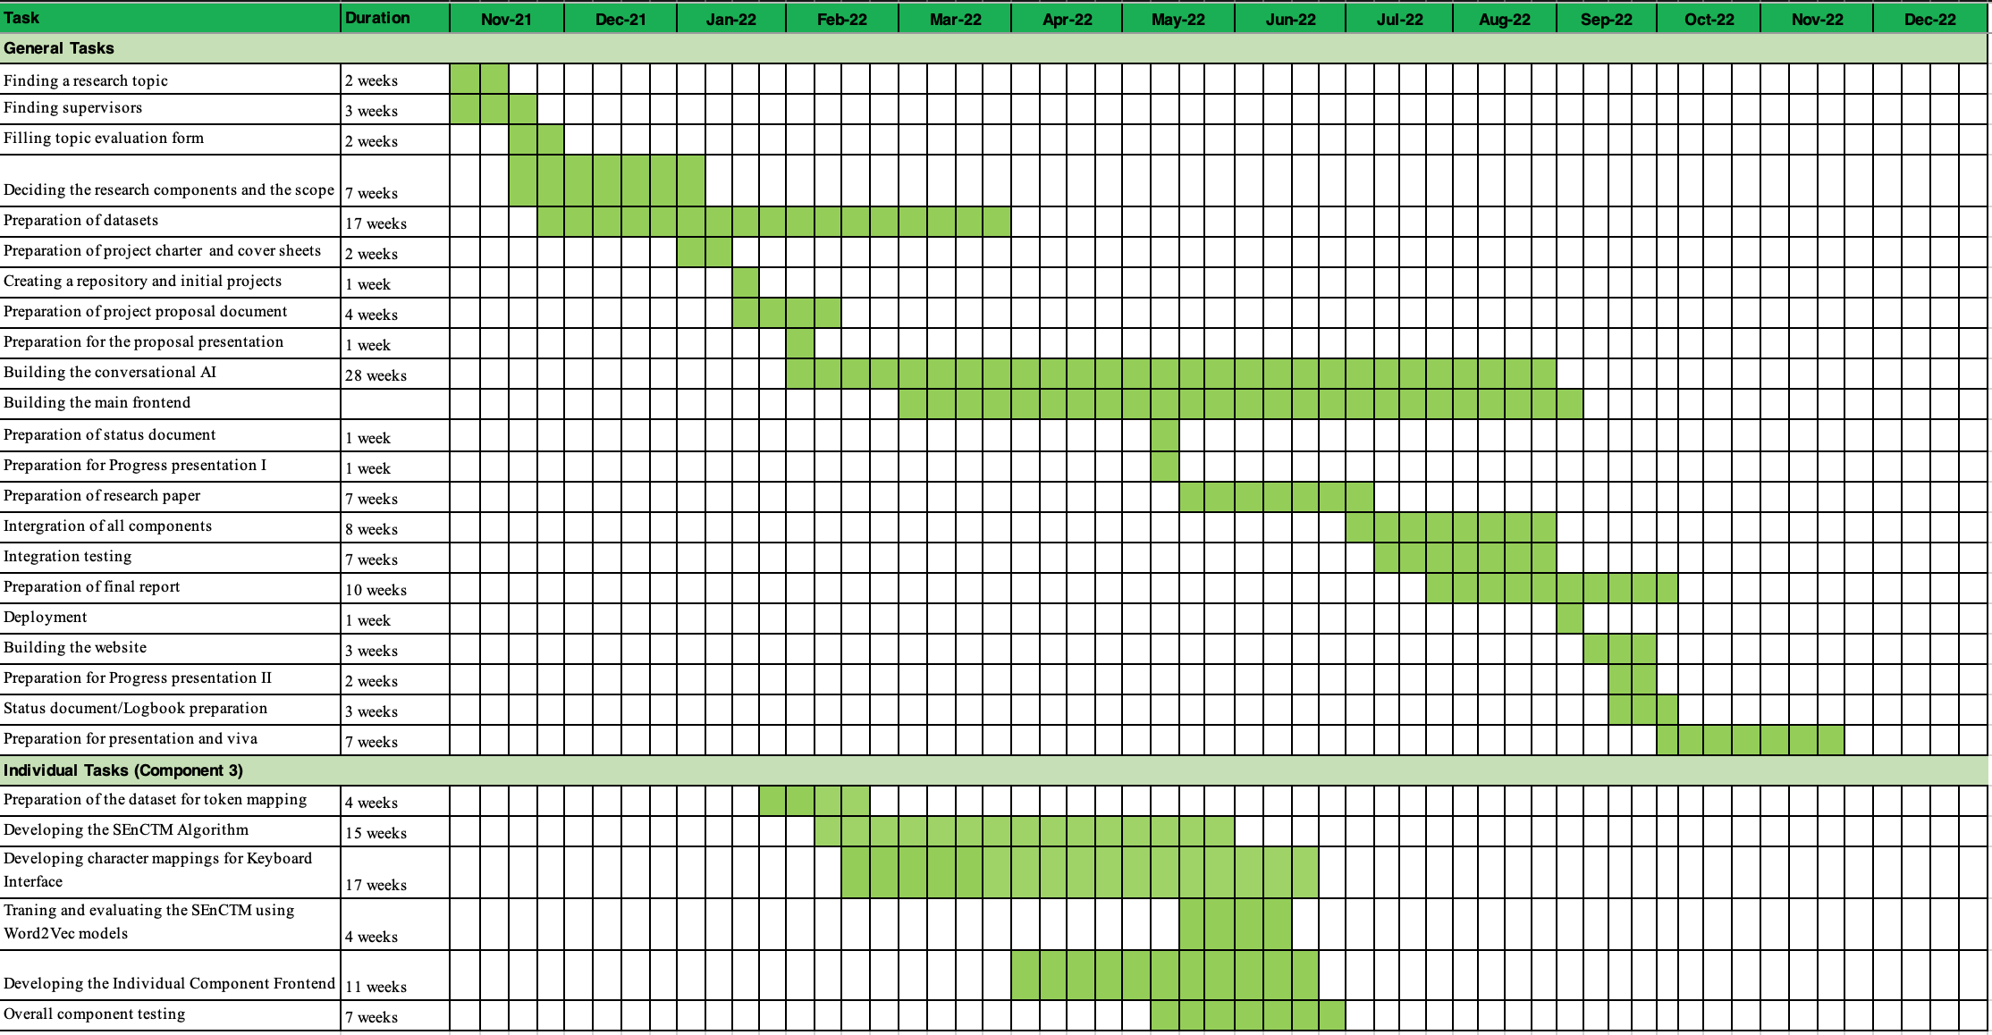
Gantt Chart

Slide 75

References
[1]. T. KasthuriArachchi and E. Y. A. Charles, "Deep Learning Approach to Detect Plagiarism in Sinhala Text," 2019 14th Conference on Industrial and Information Systems (ICIIS), 2019, pp. 314-319, doi: 10.1109/ICIIS47346.2019.9063299.
[2]. A. Kugathasan and S. Sumathipala, "Standardizing Sinhala Code-Mixed Text using Dictionary based Approach," 2020 International Conference on Image Processing and Robotics (ICIP), 2020, pp. 1-6, doi: 10.1109/ICIP48927.2020.9367353.

Slide 76

SIENA: Annotating entities using
reverse-stemming & other techniques
to develop a data annotation tool for code-mixed text data for efficient custom entity tagging.
Sakalasooriya S.A.H.A.
IT19051208
Data Science

Slide 77
Research Background
Named Entity Tagging
(places, company names, countries)
Need for Custom Entities
(domain specific name entities)
Named Entity Recognition
Faster ways to Annotate Entities
(Regular expression, Fuzzy matching)
Entities in Different Languages

Slide 78
Research Gap
SIENA can identify small variations in words
පුටුව
පුටුවක්
පුටුවේ
පුටුවක
Tool name | Collaboration features | Name Entity recommendations | Focused on Sinhala – English mixed text
ANEA | no | yes (via external knowledge source) | no
brat | no | yes (via semantic class disambiguation) | no
GATE | yes | no | no
YEDDA | no | yes (via maximum matching algorithm) | no
SIENA (This research component) | no | yes | yes

Slide 79
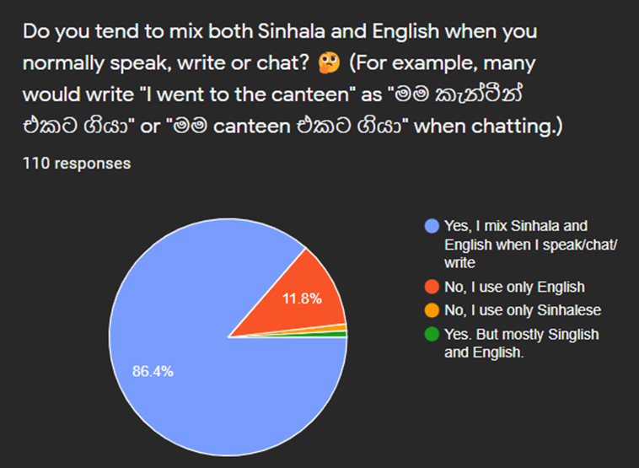
Survey Findings

Slide 80
Research Question
Why custom name entity tagging is very time consuming?
💤🥱
Any solution?
🤔

Slide 81
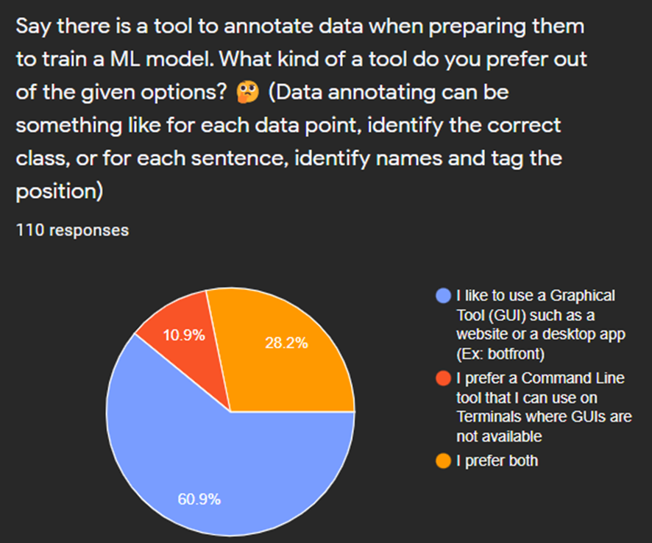
Survey Findings

Slide 82
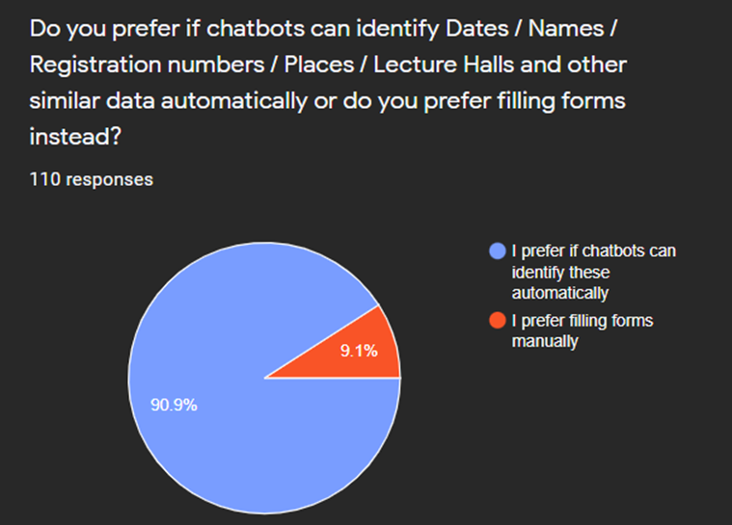
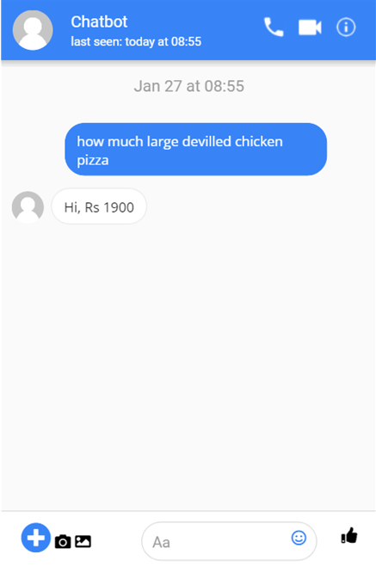
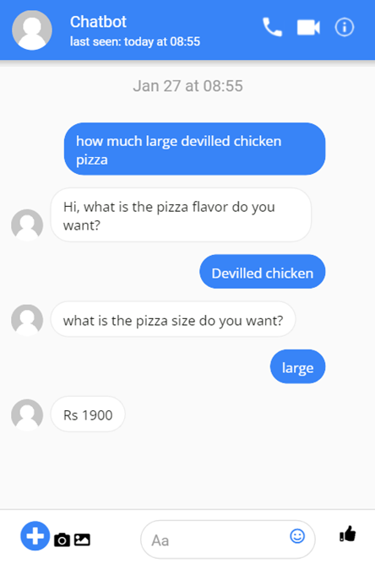
Survey Findings
Figure 1 Figure 2

Slide 83
Specific Objectives
Increase the efficiency of the text annotation process in a Sinhala-English code-switching corpus by providing accurate name entity recommendations.
IT ඩිග්‍රි එකක් කරන්න නම් A/L pass වෙන්න ඕනේ
IT ඩිග්‍රියක් කරන්න නම් A/L pass වෙන්න ඕනේ
Course type
}
Annotated by user
SIENA Recommendation : Course type

Slide 84
Sub Objectives
Define the Recommendation hierarchy
Make SIENA Compatible with Frameworks
Make Knowledge base as Moduler Component
Develop Visualizations Technique to Provide User Friendly Suggestions

Slide 85
Sub Objectives
Define the recommendation hierarchy
Order recommendations according to the algorithm evaluation results
Olive canteen එක කොහෙද තියෙන්නේ?
Via algorithm 1
Via algorithm 2
Via algorithm 3
Recommendations
Cafeteria
Course
lecturer name

Slide 86

Sub Objectives
Make SIENA compatible with frameworks
Annotated corpus need to be used in NER libraries to build NER models
spaCy v3.0 requires predefined binary format

Slide 87





Sub Objectives
Make knowledge base as moduler component
Knowledge base should be able to, Reuse
and Share across the difference installations of SIENA tool

Slide 88
Sub Objectives
Develop visualizations technique to provide user friendly suggestions
SIENA recommendations should not be a distraction to the user
User interface should be clean and elegant
Dark mode should be supported to reduce eye strain

Slide 89
Functional Requirements
User should be able to find recommended name entities
User should be able to import / upload corpus into SINEA
User should be able to export annotated text from SIENA
User should be able to import / upload portable knowledge base into SINEA
User should be able to export portable knowledge base from SINEA

Slide 90
Non-functional Requirements
SIENA should be able to handle large text corpus
SIENA should be able to easily maintain
SIENA should be able to easily install on user’s computer
SIENA should be reliable
SIENA should be secure

Slide 91
Methodology
1
Revere stemming approach development
2
Word-wise cosine similarity approach development
3
N-gram approach development

Slide 92
Methodology
Revere stemming approach
IT ඩිග්‍රි
IT ඩිග්‍රියක්
IT ඩිග්‍රිය
IT ඩිග්‍රිවල
IT ඩිග්‍රියක
Stemmed word
IT ඩිග්
Entity type: course
IT ඩිග්‍රි IT ඩිග්‍රියක් IT ඩිග්‍රිය IT ඩිග්‍රිවල IT ඩිග්‍රියක
All the Sinhala suffixes are referred by [5] “Basaka mahima – J.B Dissanayake”

Slide 93
Methodology
Word-wise cosine similarity
Letter 2
Word 1
•
Word 2
•
θ
Letter 1

Slide 94
Methodology
N-gram approach
Letters of “IT ඩිග්‍රියක්” can three gram into
“IT “
“T ඩි”
“ඩිග්‍රි”
“ඩිග්‍රිය”
“ග්‍රියක්”
When comparing two words we can count how many n-grams are matching

Slide 95
Work Breakdown Structure
SIENA
1
Data Preparation
2
Algorithm Development
3
UI Development
NER model Implementation
Deployment
4
5
Data Collection
Revere stemming approach development
SIENA CLI
Build NLP pipeline
Update the GIT Repository
Data Augmentation
SIENA GUI
Build NER model
Set up GCP Instance
Word-wise cosine similarity approach development
Data Deduplication
Flask server implementation
Deploy SIENA
Data Preprocessing
N-gram approach development
Algorithm evaluation

Slide 96
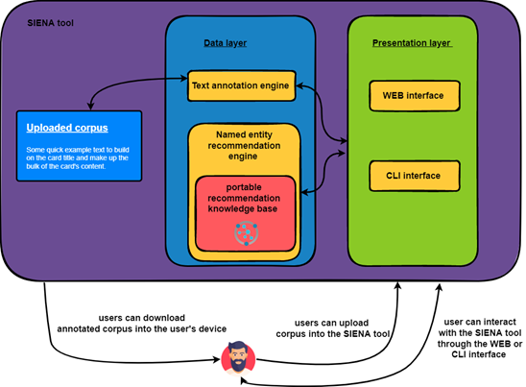
Individual Component Architecture

Slide 97
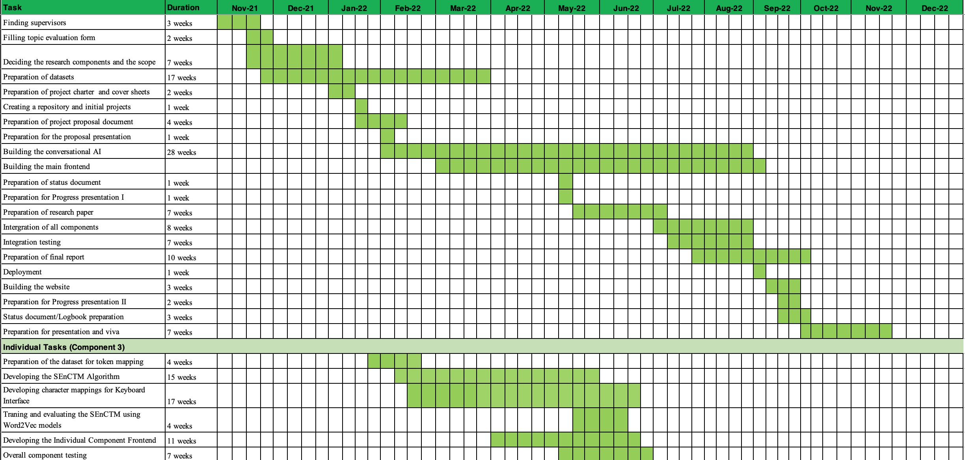
Gantt chart

Slide 98
References
[1] Anastasia Zhukova, Felix Hamborg, Bela Gipp, ‘ANEA: Automated (Named) Entity Annotation for German Domain-Specific Texts’ Available: https://arxiv.org/pdf/2112.06724.pdf
[2] Pontus Stenetorp, Sampo Pyysalo, Goran Topic, Tomoko Ohta, Sophia Ananiadou, and Jun’ichi Tsujii, ‘BRAT: a Web-based Tool for NLP-Assisted Text Annotation’ Available: https://aclanthology.org/E12-2021.pdf
[3] Kalina Bontcheva, Hamish Cunningham, Ian Roberts, Angus Roberts, Valentin Tablan, Niraj Aswani, Genevieve Gorrell, ‘GATE Teamware: a web-based, collaborative text annotation framework’, Available: https://www.jstor.org/stable/42636386
[4] Jie Yang, Yue Zhang, Linwei Li, Xingxuan Li, ‘YEDDA: A Lightweight Collaborative Text Span Annotation Tool’, Available: https://aclanthology.org/P18-4006.pdf
[5]J.B Dissanayake, Basaka mahima, ISBN: 9789556963656
[6] "Spacy Styleguide",
https://spacy.io/styleguide
[7] "Spacy Data formats · spaCy API Documentation",
https://spacy.io/api/data-formats
[8] "Vector Icons and Stickers - PNG, SVG, EPS, PSD and CSS",
https://www.flaticon.com/

Slide 99

Overall
Commercialization Plan

Slide 100



DEMO
Free for 1 Month
10 Intents/Question Categories
2 API Integrations
Bot Analytics Included
Unlimited CDD Improvements
$ 199.99/One Time
ON PREM
2 Free Maintenance.
($9.99 per additional call)
Bot Analytics + CDD
PACKAGE
PACKAGE
STARTER
PRO
GENIUS
CaaS
$ 9.99/Month
$ 34.99/Month
$ 49.99/Month
PACKAGES
20 Intents/Question Categories
2 API Integrations
No Bot Analytics
Unlimited CDD Improvements
180 Intents
110 API Integrations
Bot Analytics Included
CDD + Sinhala Entity Annotating
400 Intents
200 API Integrations
Bot Analytics Included
CDD + ML Packages

Slide 101

Budget Plan

Slide 102
Component Name
Individual Item Price (LKR)
Number of Items
Duration
Total Item Price (LKR)
Domain Name
2148.43/year
1
1 year
2148.43
GCP Instance
10683.84/month
1
6 months
64,103.06
Reference Book: Basaka Mahima by J.B. Dissanayake
1250.00
1
-
1250.00
Research Paper Publication
25000.00
-
-
25000.00
Grand Total
-
-
-
92,501.49

Slide 103
Thank You

Slide 104


Any Questions

